Slide 1
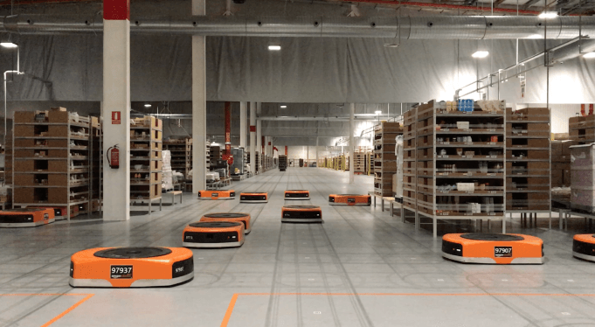
Amazon Robotics machines in a Amazon warehouse
Collision avoidance and coordination for a fleet of robots
Luca Marseglia

Slide 2
Additional plots (pie chart & robot distances)
2024 October | Slide 2

Slide 3
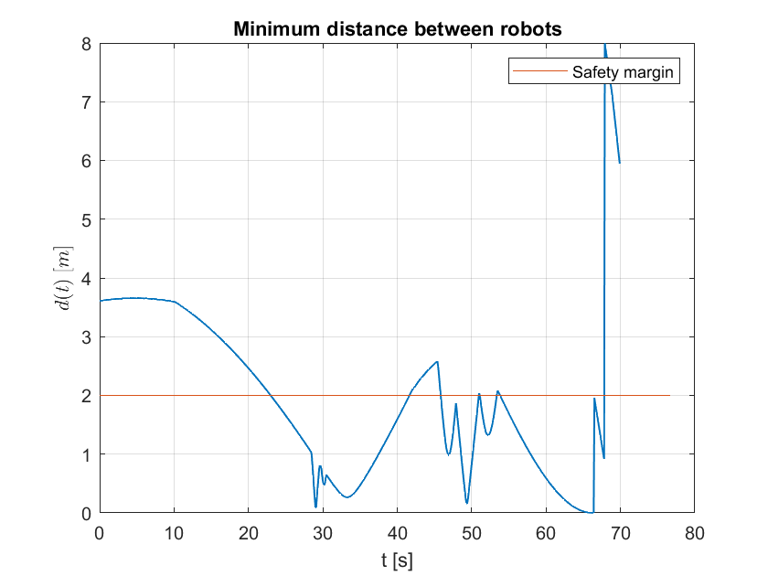
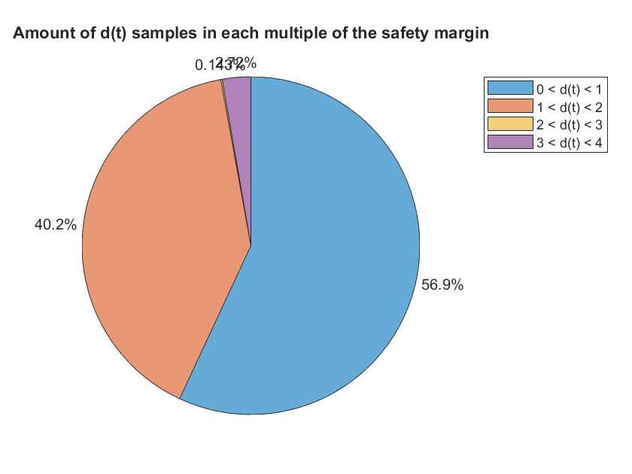
Pie charts – Before optimization
2024 October | Slide 3

Slide 4
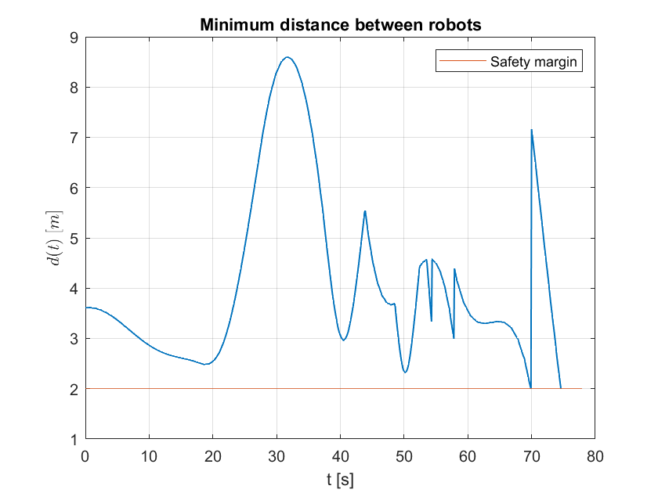
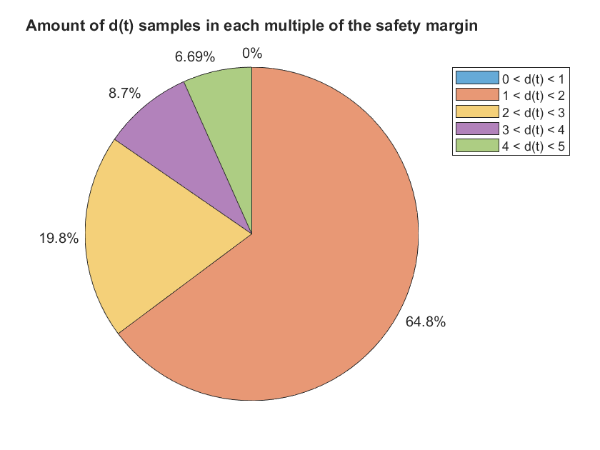
Pie charts – After optimization
2024 October | Slide 4

Slide 5
Pie charts - Comparison
Before
After
2024 October | Slide 5

Slide 6
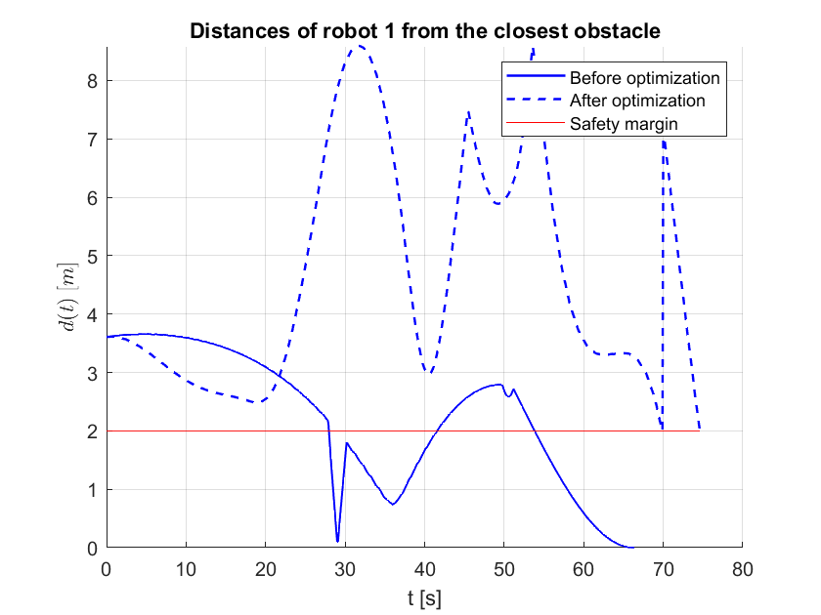
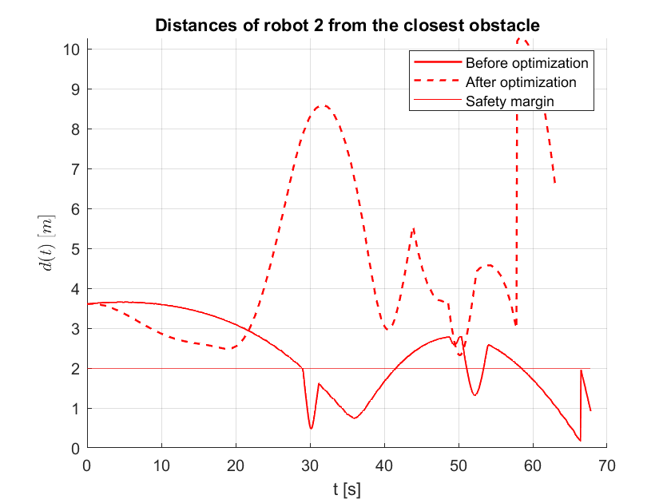
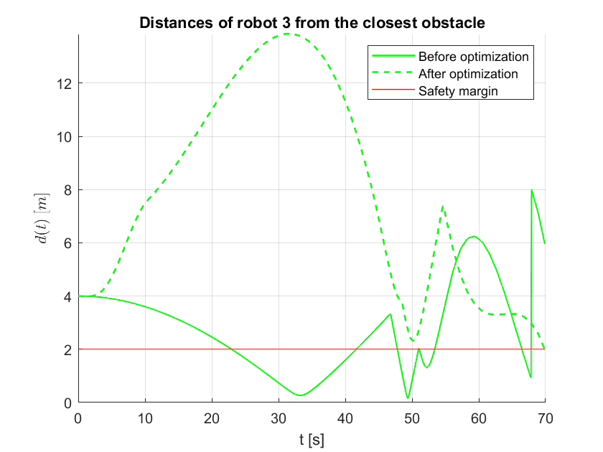
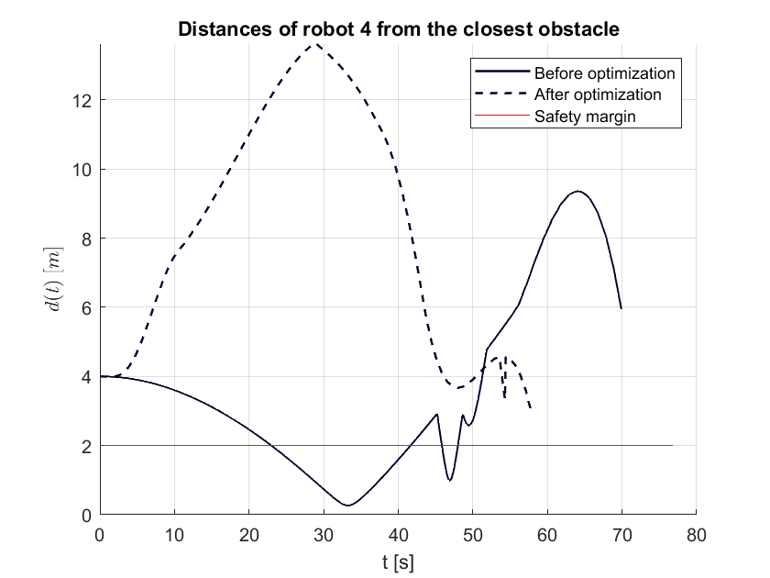
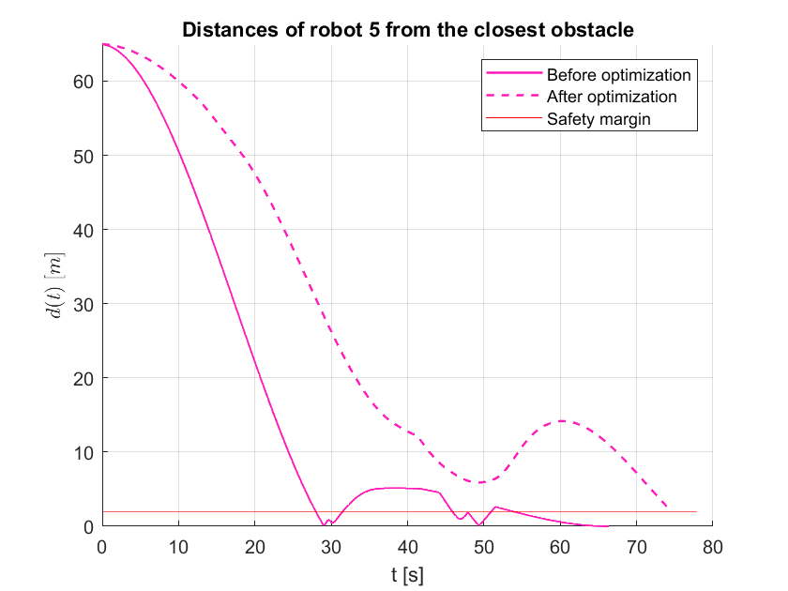
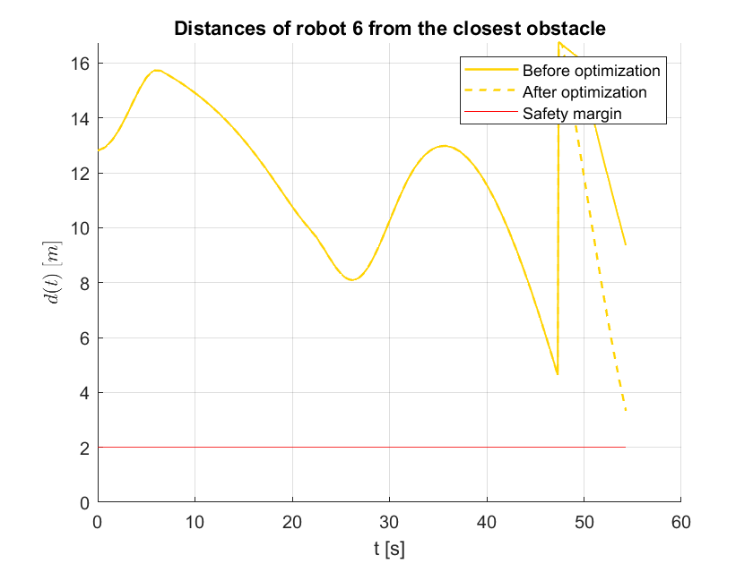
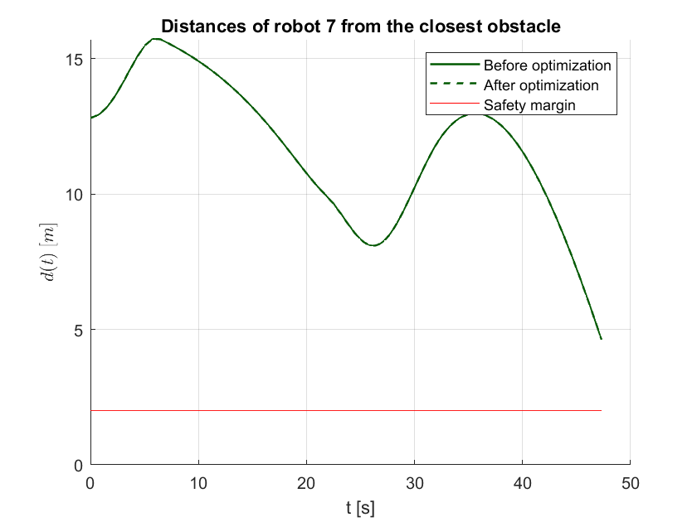
Robot distances
2024 October | Slide 6

Slide 7
Parameters analysis

Slide 8
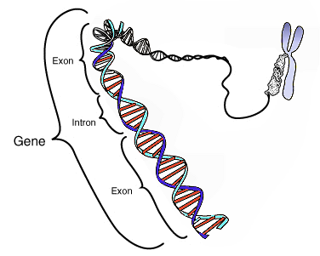
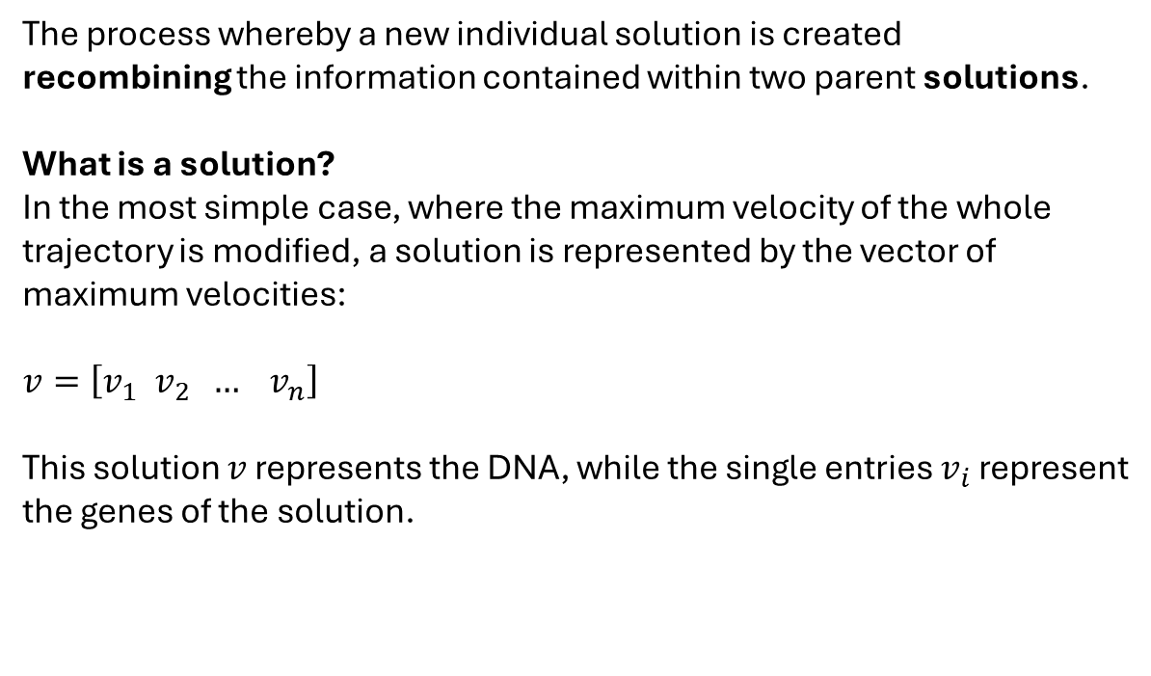
Crossover
The process whereby a new individual solution is created
recombining the information contained within two parent solutions.
What is a solution?
In the most simple case, where the maximum velocity of the whole trajectory is modified, a solution is represented by the vector of maximum velocities:
$$v=\left[v_{1} v_{2} … v_{n}\right]$$
This solution $v$ represents the DNA, while the single entries $v_{i}$ represent the genes of the solution.
2024 October | Slide 8

Slide 9
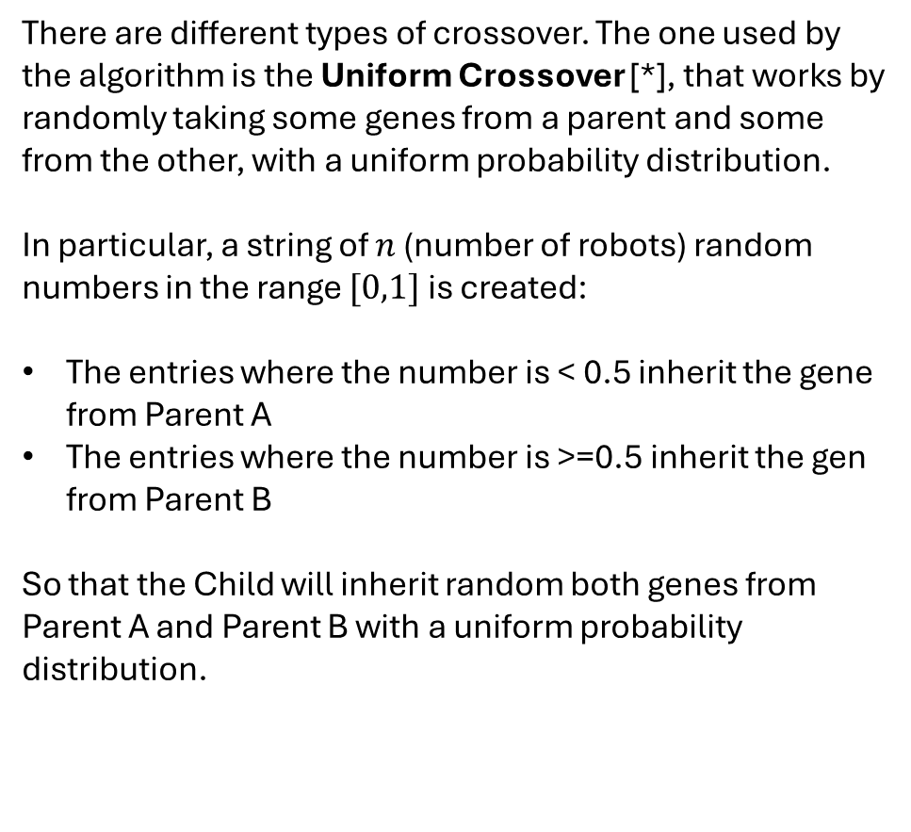
Recombination
n = 3
There are different types of crossover. The one used by the algorithm is the Uniform Crossover [*], that works by randomly taking some genes from a parent and some from the other, with a uniform probability distribution.
In particular, a string of $n$ (number of robots) random numbers in the range $[0,1]$ is created:
The entries where the number is < 0.5 inherit the gene from Parent A
The entries where the number is >=0.5 inherit the gen from Parent B
So that the Child will inherit random both genes from Parent A and Parent B with a uniform probability distribution.
Parent A
Parent B
1.23 | 0.81 | 1.45
0.72 | 0.99 | 1.34
Mask
0.3 | 0.2 | 0.8
Threshold = 0.5
1.23 | 0.81 | 1.45
0.72 | 0.99 | 1.34
Child
1.23 | 0.81 | 1.34
2024 October | Slide 9

Slide 10
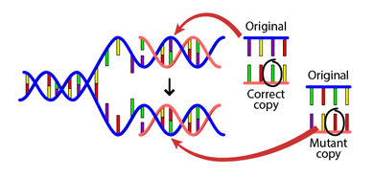
Mutation
Mutation is the process that uses only one parent and creates one child by applying some randomised change to the solution.
The change is applied by altering some genes by adding a random step value to them.
There exist different ways to mutate genes, which depend on the way the step is chosen. The one used by the algorithm is the Self-adaptive Mutation.
2024 October | Slide 10

Slide 11
Self-adaptive Mutation
The key concept is that the mutation step sizes are not set by the user; rather they coevolve with the solutions.
In order to achieve this behavior it is essential to modify the value of the step first, and then mutate the solutions with the new value of the step. [*]
The rationale behind this is that a new individual is effectively evaluated twice:
Primarily, it is evaluated directly for its feasbility.
Second, it is evaluated for its ability to create good offspring.
Parent
1.23 | 0.81 | 1.45
Step
+0.13 | -0.27 | +0.05
Child
1.36 | 0.54 | 1.50
2024 October | Slide 11

Slide 12
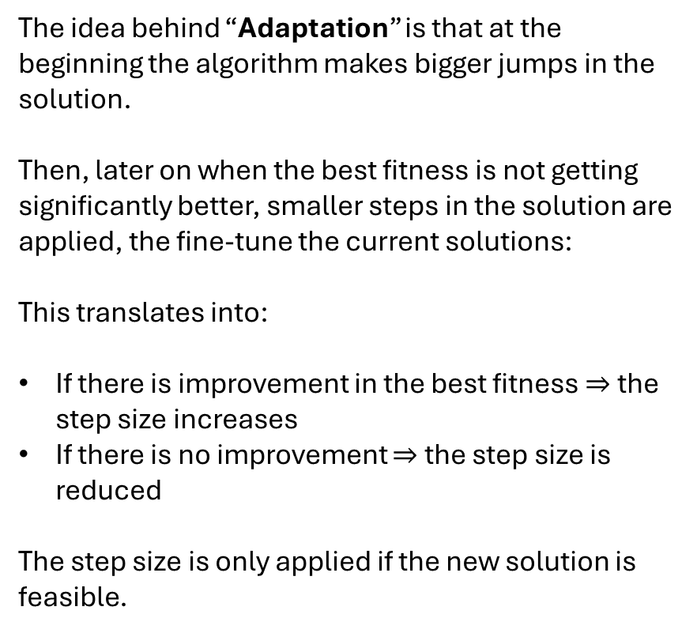
Self-adaptive Mutation
if state.Best(end) < state.Best(end-1)
StepSize = min(1,StepSize*4);
else
StepSize = max(sqrt(eps),StepSize/4);
end
[…]
mutant = x + StepSize*scale.*direction;
if feasible
mutationChildren(i,:) = mutant’;
break;
else
mutationChildren(i,:) = x';
end
The idea behind “Adaptation” is that at the beginning the algorithm makes bigger jumps in the solution.
Then, later on when the best fitness is not getting significantly better, smaller steps in the solution are applied, the fine-tune the current solutions:
This translates into:
If there is improvement in the best fitness $⇒$ the step size increases
If there is no improvement $⇒$ the step size is reduced
The step size is only applied if the new solution is feasible.
The direction and the scale are to ensure that the muation moves into a feasible direction
2024 October | Slide 12

Slide 13
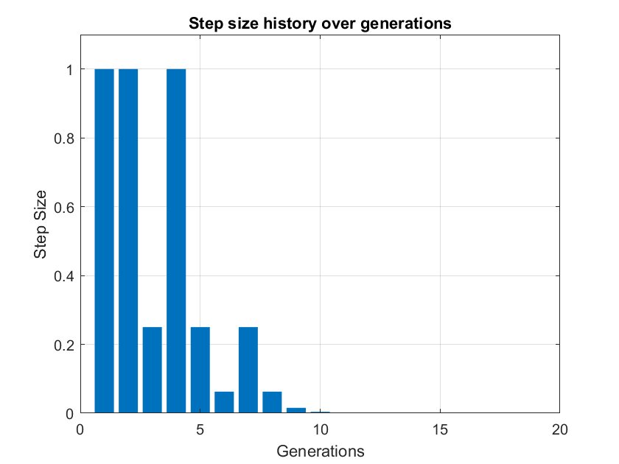
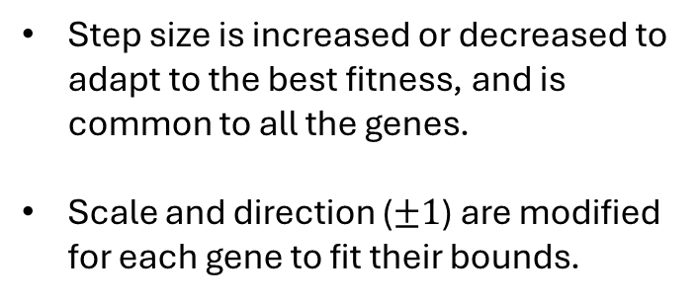
Self-adaptive Mutation
Step size is increased or decreased to adapt to the best fitness, and is common to all the genes.
Scale and direction ($±1$) are modified for each gene to fit their bounds.
mutant = x + StepSize*scale.*direction
2024 October | Slide 13

Slide 14
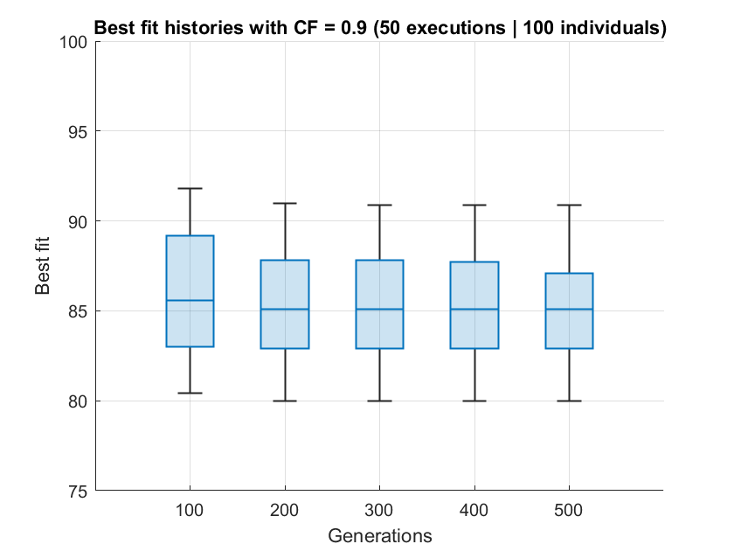
Self-adaptive Mutation
Since the Mutation Rate is not relevant with Self-adaptive mutation, only the Crossover Fraction can be analyzed.
2024 October | Slide 14

Slide 15
Uniform Mutation
With this type of mutation, each gene has a “rate” probability of being mutated.
If the gene is selected to be mutated in the next generation, the new gene will have a random value selected uniformly in a range within the bounds of the solution.
Parent
1.23 | 0.81 | 1.45
Mask
0.3 | 0.1 | 0.7
Rate = 0.2
Child
1.23 | 1.11 | 1.45
2024 October | Slide 15

Slide 16
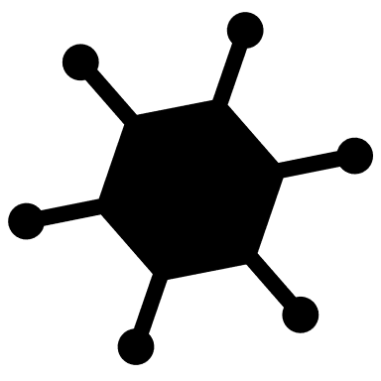
Crossover Fraction
This factor determines the percentage of the population that will be created through crossover in the next generation. The remaining population will be created through mutation.
The individuals that undergo crossover are selected through the Stochastic Uniform Selection, that assigns them a probability to be selected proportional to their fitness.
generation k
generation k+1
Elitism: 10%
Crossover Fraction: 80%
2024 October | Slide 16

Slide 17
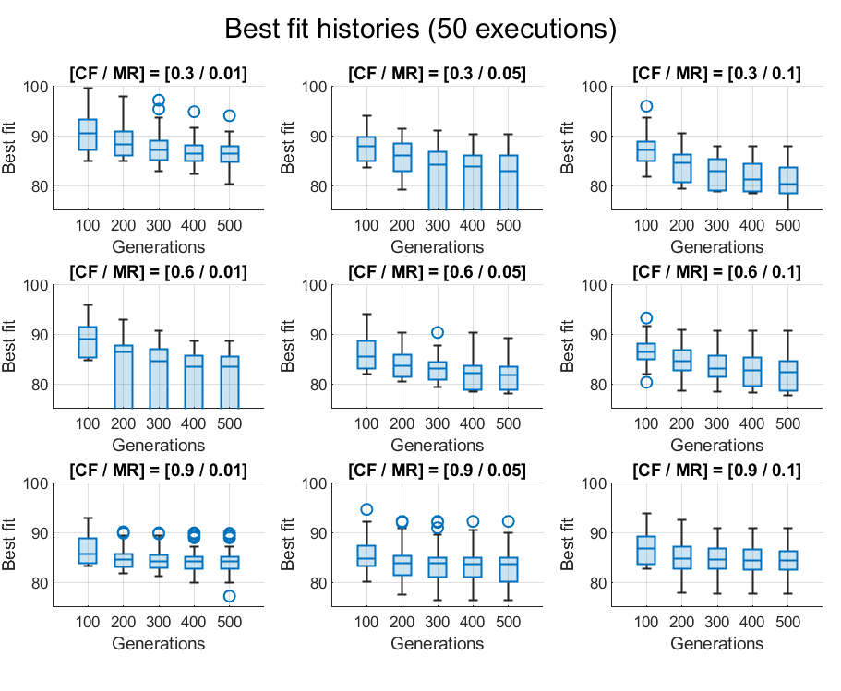
Parameters selection – Uniform Mutation
MR
In order to search for the best parameters, Uniform Mutation can be used so as to over a better control over the mutation by changing the Mutation Rate.
MR CF | 0.01 | 0.05 | 0.1
0.3 | 0.01 0.3 | 0.05 0.3 | 0.1 0.3
0.6 | 0.01 0.5 | 0.05 0.5 | 0.1 0.5
0.9 | 0.01 0.9 | 0.05 0.9 | 0.1 0.9
CF

Slide 18
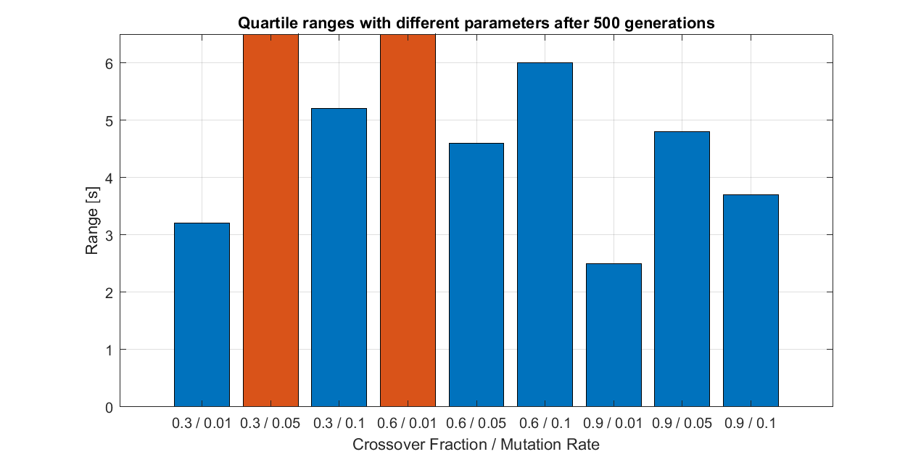
Parameters selection

Slide 19
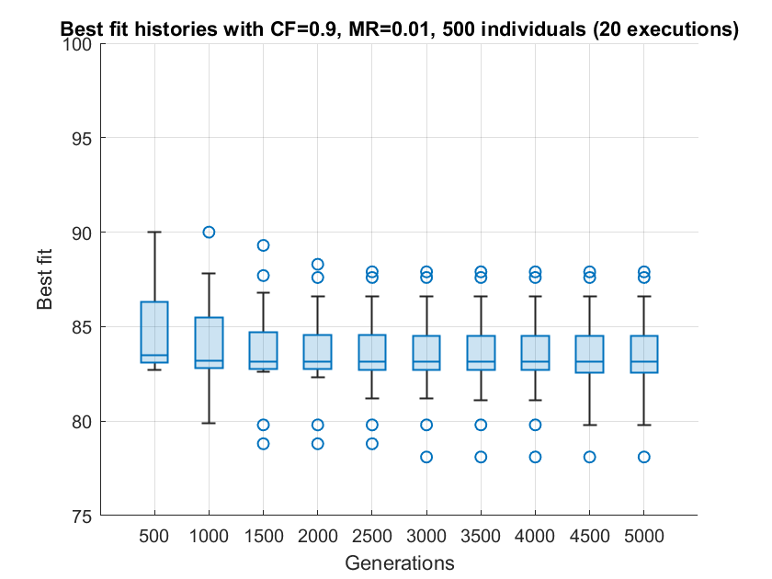
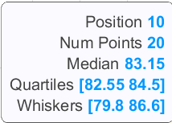
Parameters selection

Slide 20
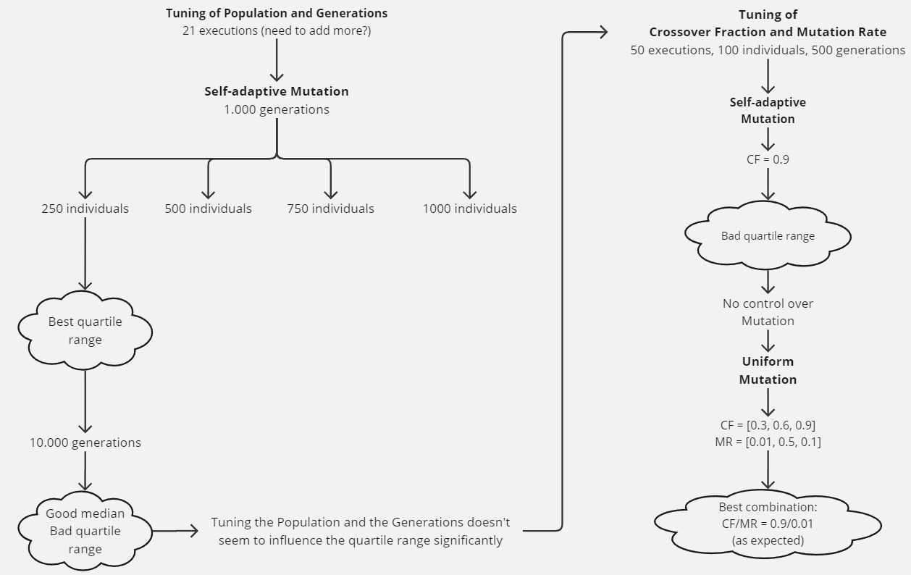
Recap

